Slide 1
Mortality & Switch Year Calculations
Friday 6/12/2018

Slide 2
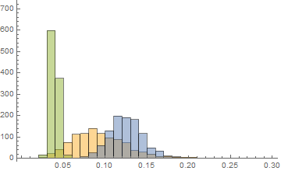
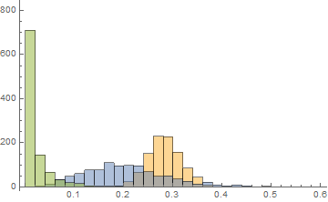
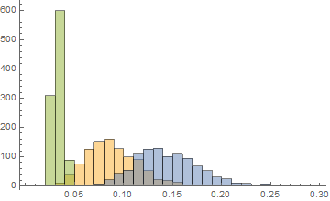
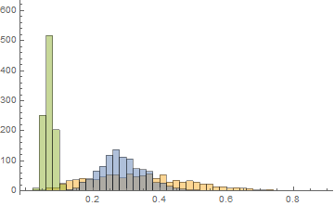
No assumptions, mortality (AB): sepsis=orange, pneu=blue, uti=green
CBPs (susceptible)
CBPs (resistant)
Alt (susceptible)
Alt (resistant)
Notes:
no assumptions

Slide 3
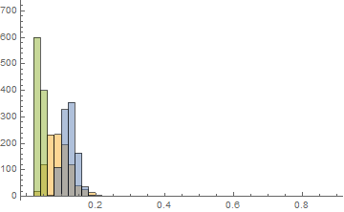
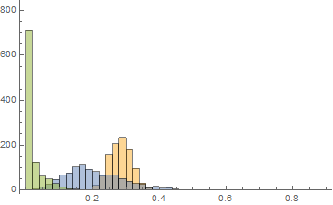
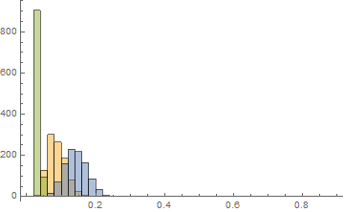
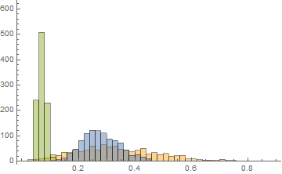
No assumptions, mortality (AB): sepsis=orange, pneu=blue, uti=green
CBPs (susceptible)
CBPs (resistant)
Alt (susceptible)
Alt (resistant)
Notes:
no assumptions

Slide 4
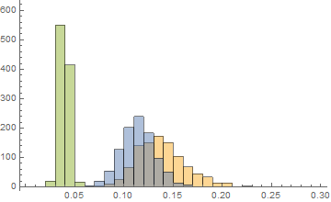
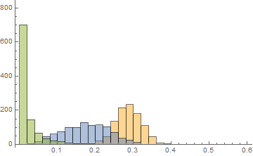
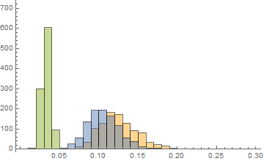
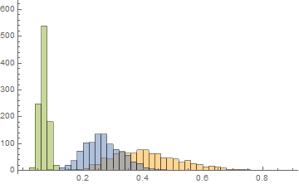
+ assumptions, mortality (AB): sepsis=orange, pneu=blue, uti=green
CBPs (susceptible)
CBPs (resistant)
Alt (susceptible)
Alt (resistant)
Notes:
no assumptions

Slide 5
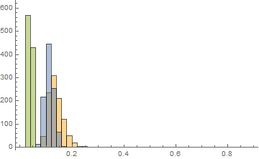
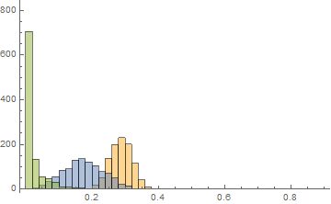
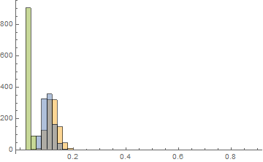
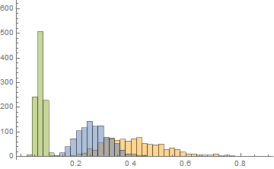
+ assumptions, mortality (AB): sepsis=orange, pneu=blue, uti=green
CBPs (susceptible)
CBPs (resistant)
Alt (susceptible)
Alt (resistant)
Notes:
no assumptions

Slide 6
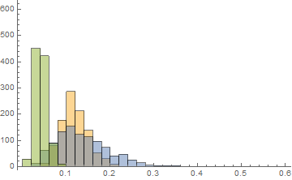
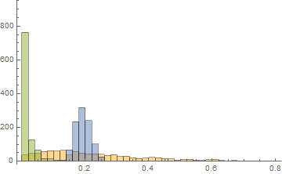
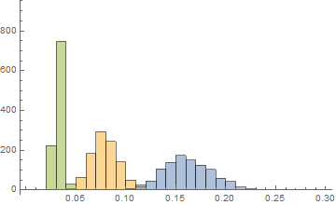
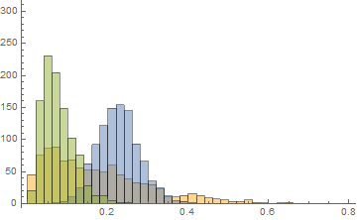
No assumptions, mortality (KP): sepsis=orange, pneu=blue, uti=green
CBPs (susceptible)
CBPs (resistant)
Alt (susceptible)
Alt (resistant)
Notes:
~60/100,000 pneumonia & sepsis, alt, susceptible, KP

Slide 7
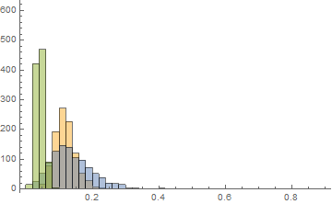
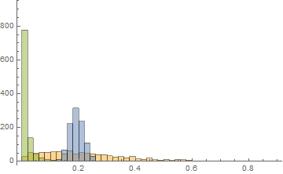
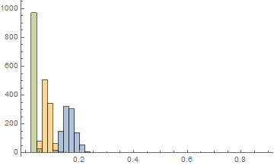
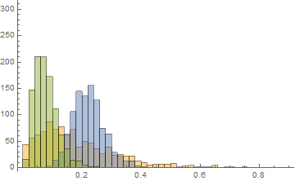
No assumptions, mortality (KP): sepsis=orange, pneu=blue, uti=green
CBPs (susceptible)
CBPs (resistant)
Alt (susceptible)
Alt (resistant)
Notes:
~60/100,000 pneumonia & sepsis, alt, susceptible, KP

Slide 8
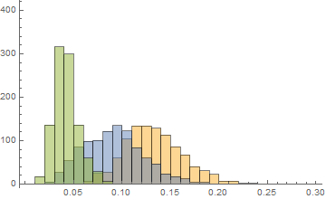
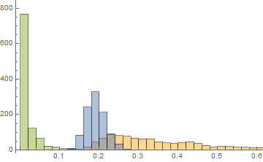
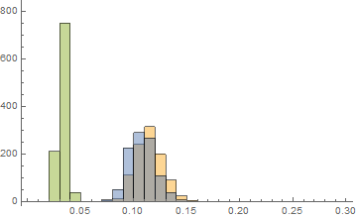
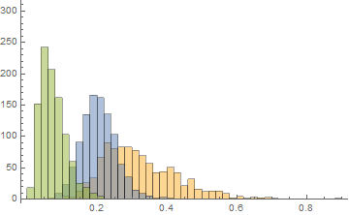
+ assumptions, mortality (KP): sepsis=orange, pneu=blue, uti=green
CBPs (susceptible)
CBPs (resistant)
Alt (susceptible)
Alt (resistant)
Notes:
~60/100,000 pneumonia & sepsis, alt, susceptible, KP

Slide 9
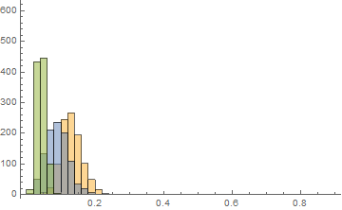
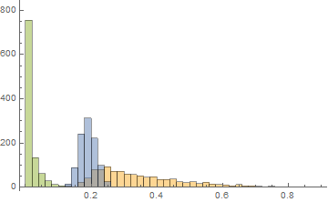
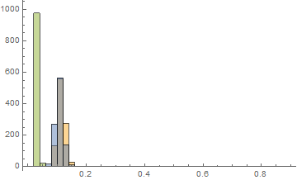
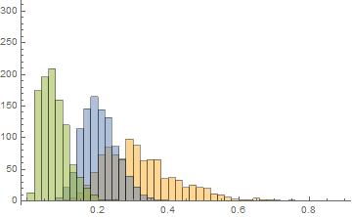
+ assumptions, mortality (KP): sepsis=orange, pneu=blue, uti=green
CBPs (susceptible)
CBPs (resistant)
Alt (susceptible)
Alt (resistant)
Notes:
~60/100,000 pneumonia & sepsis, alt, susceptible, KP

Slide 10
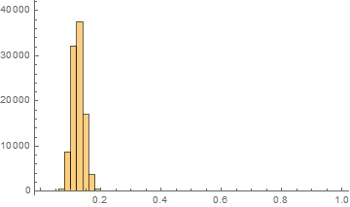
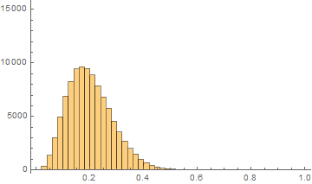
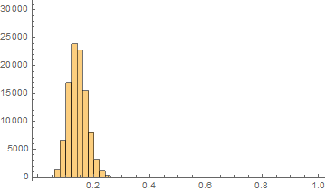
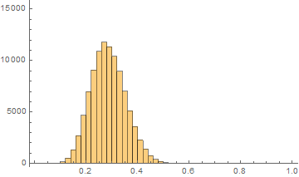
Mortality -------AB, pneu
CBPs (susceptible)
Mean: 0.125
CBPs (resistant)
Mean: 0.202
Alt (susceptible)
Mean: 0.143
Alt (resistant)
Mean: 0.286
Notes:
*mortality associated with alternatives are higher than CBPs for resistant bacteria
For values = 0, +0.001 to fit prior

Slide 11
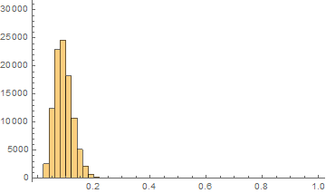
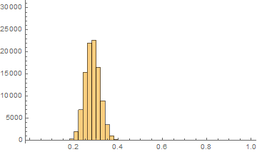
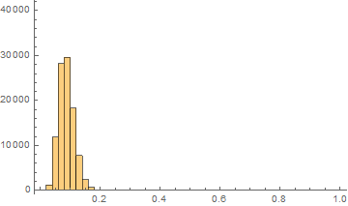
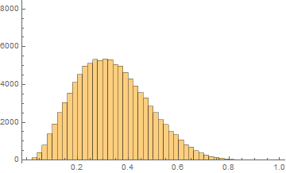
Mortality -------AB, sepsis
CBPs (susceptible)
Mean: 0.093
CBPs (resistant)
Mean: 0.283
Alt (susceptible)
Mean: 0.088
Alt (resistant)
Mean: 0.337
Notes:
Mortality associated with alt, susceptible < CBP, susceptible
alt, resistant > CBP, resistant

Slide 12
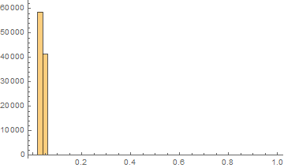
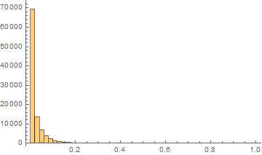
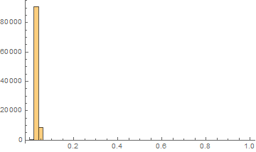
Mortality -------AB, UTI
CBPs (susceptible)
Mean: 0.039
CBPs (resistant)
Mean: 0.021
Alt (susceptible)
Mean: 0.033
Alt (resistant)
Mean: 0.070
Notes:
Mortality associated with alt, susceptible < CBP, susceptible
alt, resistant > CBP, resistant

Slide 13
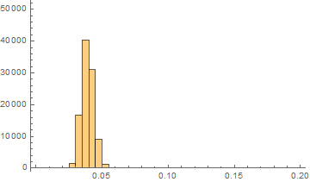
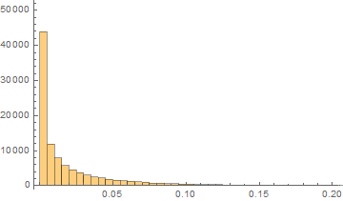
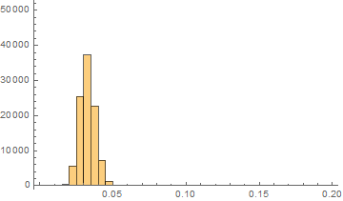
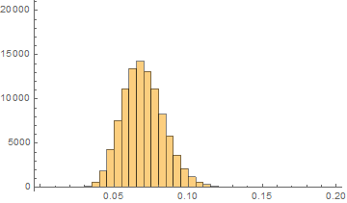
Mortality -------AB, UTI (2)
CBPs (susceptible)
Mean: 0.039
CBPs (resistant)
Mean: 0.021
Alt (susceptible)
Mean: 0.033
Alt (resistant)
Mean: 0.070

Slide 14
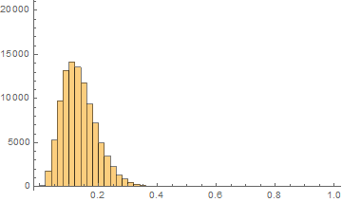
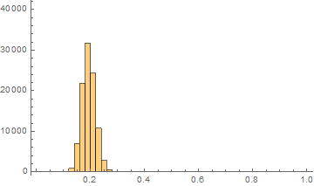
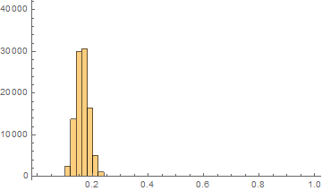

Mortality -------KP, pneu
CBPs (susceptible)
Mean: 0.136
CBPs (resistant)
Mean: 0.194
Alt (susceptible)
Mean: 0.163
Alt (resistant)
Mean: 0.224

Slide 15




Mortality -------KP, sepsis
CBPs (susceptible)
Mean: 0.120
CBPs (resistant)
Mean: 0.223
Alt (susceptible)
Mean: 0.079
Alt (resistant)
Mean: 0.175

Slide 16




Mortality -------KP, UTI
CBPs (susceptible)
Mean: 0.043
CBPs (resistant)
Mean: 0.014
Alt (susceptible)
Mean: 0.033
Alt (resistant)
Mean: 0.077

Slide 17




Mortality -------KP, UTI (2)
CBPs (susceptible)
Mean: 0.043
CBPs (resistant)
Mean: 0.014
Alt (susceptible)
Mean: 0.033
Alt (resistant)
Mean: 0.077

Slide 18

Mortality calculations
# deaths prior to switch year (CBPs only)
$\left(n_{ip} ×r_{ip} ×m_{cr}\right)+\left(n_{ip}×\left(1−r_{ip}\right)×m_{cs}\right)$
# deaths associated with CBPs post switch year
$\left(n_{cip}×r_{ip}×m_{ar}\right)+(n_{cip}×(1−r_{ip})×m_{as})$
# deaths associated with alternatives post switch year
$\left(n_{aip}×r_{ip}×m_{ar}\right)+(n_{aip}×(1−r_{ip})×m_{as})$
$n_{ip}$= $n_{cip}$+ $n_{aip}$
Notes:
i=indication
p=pathogen
c=cbps
a=alternatives

Slide 19
Acinetobacter

Slide 20


CBP consumption- AB, pneu
Resistance freq - AB, pneu
(one trial, e.g.)
Switch year
2040
2022
CBP Consumption (SU/1000 pop)
2018
Resistance frequency
stewardship
year
year

Slide 21

Prevalence-AB, pneu
Status quo
Alternatives
Steady state (2018-2040)
CBPs

Slide 22


Cumulative mortality (2018-2080) v. Switch year (2018-2040)------AB, pneu
All 950 trials
Median of 950 trials
Cumulative mortality
Switch year

Slide 23


Yearly mortality (median over all trials)– AB, pneu
undiscounted
2022 (green)
2018
2022
2018 (blue)
2040
# deaths
2040 (orange)
discounted
year
*different lines are different switch years

Slide 24


Yearly mortality (one random trial)– AB, pneu
2040 (orange)
2022 (green)
# deaths
Cumulative mortality
2018
discounted
year
Switch year
Mortality | Susceptible | Resistant
CBPs | 0.14 | 0.18
Alternatives | 0.14 | 0.24
*different lines are different switch years
Notes:
At late years-
Fewer deaths associated with alt therapy at late switch years, but more deaths associated with cbp therapy

Slide 25


Yearly mortality (one random trial)– AB, pneu
2022 (green)
2040
Cumulative mortality
# deaths
2018 (blue)
discounted
year
Switch year
Mortality | Susceptible | Resistant
CBPs | 0.11 | 0.26
Alternatives | 0.12 | 0.14
*different lines are different switch years

Slide 26



Deaths post switch year associated with alternative therapy
2040
Deaths post switch year associated with CBP therapy
+
2022
2018
=

Slide 27
Klebsiella

Slide 28


CBP consumption- KP, pneu
Resistance freq - KP, pneu
(one trial, e.g.)
Switch year
2040
2022
CBP Consumption (SU/1000 pop)
2018
Resistance frequency
stewardship
year
year

Slide 29

Prevalence-KP, pneu
Status quo
Alternatives
Steady state (2018-2040)
CBPs

Slide 30


Cumulative mortality (2018-2080) v. Switch year (2018-2040)------KP, pneu
Median of 950 trials
Cumulative mortality
All 950 trials
Switch year

Slide 31


Yearly mortality (median over all trials)– KP, pneu
undiscounted
2040
2022
2018
# deaths
discounted
year
*different lines are different switch years

Slide 32


Yearly mortality (one random trial)– KP, pneu
2040 (orange)
2022 (green)
# deaths
Cumulative mortality
2018 (blue)
discounted
year
Switch year
Mortality | Susceptible | Resistant
CBPs | 0.09 | 0.20
Alternatives | 0.14 | 0.26
*different lines are different switch years
Notes:
Alternatives > CBPs for resistant

Slide 33



Deaths post switch year associated with alternative therapy
2040
Deaths post switch year associated with CBP therapy
+
2022
2018
=

